Slide 1
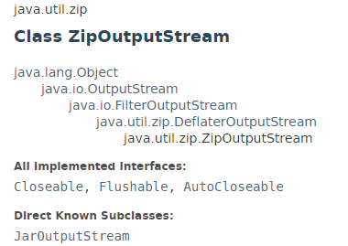
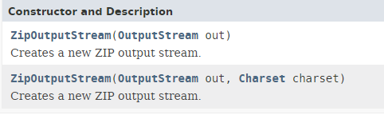
ZipOutputStream
Java comes with “java.util.zip” library to perform data compression in Zip format.
Read file with “FileInputStream”
Add the file name to “ZipEntry” and output it to “ZipOutputStream“

Slide 2
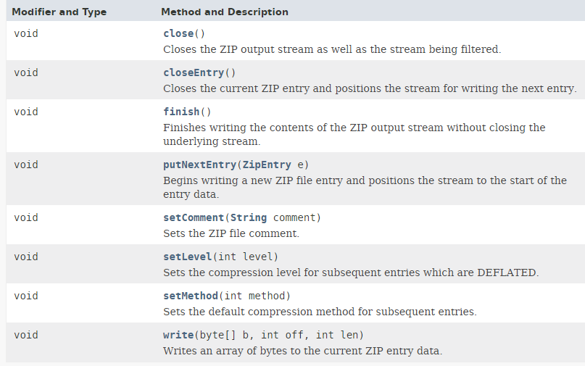
ZipOutputStream

Slide 3
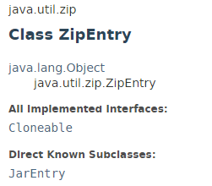
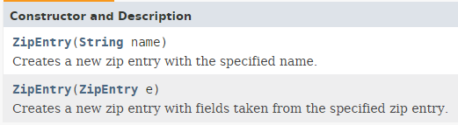
ZipEntry

Slide 4
RandomAccessFile
https://docs.oracle.com/javase/8/docs/api/index.html?java/util/zip/ZipOutputStream.html
https://docs.oracle.com/javase/8/docs/api/java/util/zip/ZipEntry.html

